Slide 1
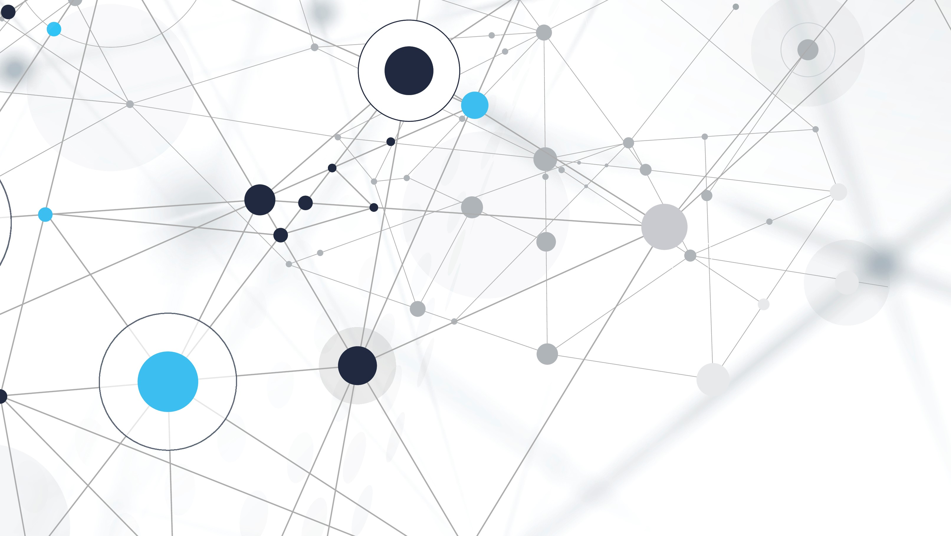
Deployment of ADF in an Azure DevOps CI/CD environment
Erik Esmaty – Data Saturday Rheinland – 17.06.2023

Slide 2
AGENDA
What is Continuous Integration / Continuous Deployment?
Setup of Azure DevOps
Setup of Azure Data Factory
Deploy ADF artifacts
Build artifacts
Release artifacts
The “not-agenda”:
Developing pipelines in ADF
Choosing branching strategies

Slide 3

Who am i?
Team Lead Consulting @ PIA DYMATRIX in Munich
Worked with MS Data Platform products since 2008
RGV of PASS Bavaria, part of PASS Germany
Organizer of Data Saturdays in Munich
https://www.linkedin.com/in/esmaty/
Next edition:
February 24th, 2024

Slide 4
Continuous Integration / Continuous Deployment
“CI/CD is a method to frequently deliver apps to customers by introducing automation into the stages of app development. The main concepts attributed to CI/CD are continuous integration, continuous delivery, and continuous deployment. CI/CD is a solution to the problems integrating new code can cause for development and operations teams (AKA "integration hell").”
Source: www.redhat.com

Slide 5
Continuous Integration / Continuous Deployment
Happier users and customers
Accelerated time-to-value
Less fire fighting
Hit dates more reliably
Free up developers' time
Less context switching
Recover faster
Source: www.gitlab.com

Slide 6
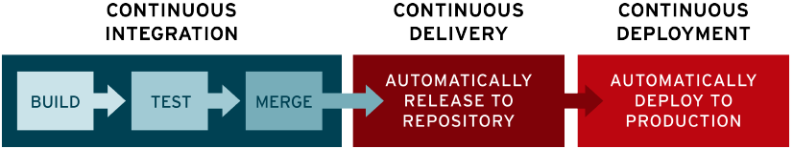
Continuous Integration / Continuous Deployment
Source: www.redhat.com

Slide 7
ADF CI/CD Lifecycle
Development ADF with Azure Repos Git
Feature branches to make changes
Pull request into main
Merge into main branch
Deployment to UAT
Deployment to production environment
Source: www.microsoft.com

Slide 8
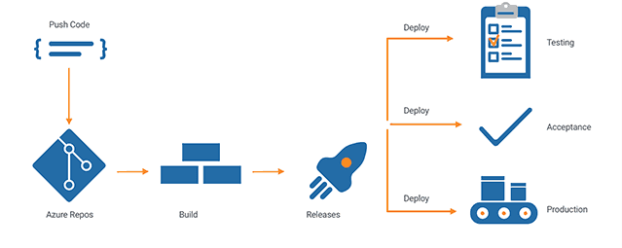
ADF CI/CD Lifecycle
Source: www.hugobarona.com

Slide 9
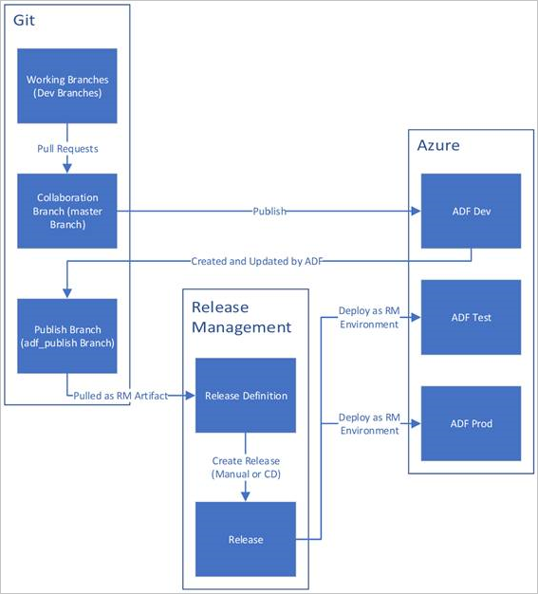
ADF CI/CD Lifecycle
Source: www.microsoft.com

Slide 10
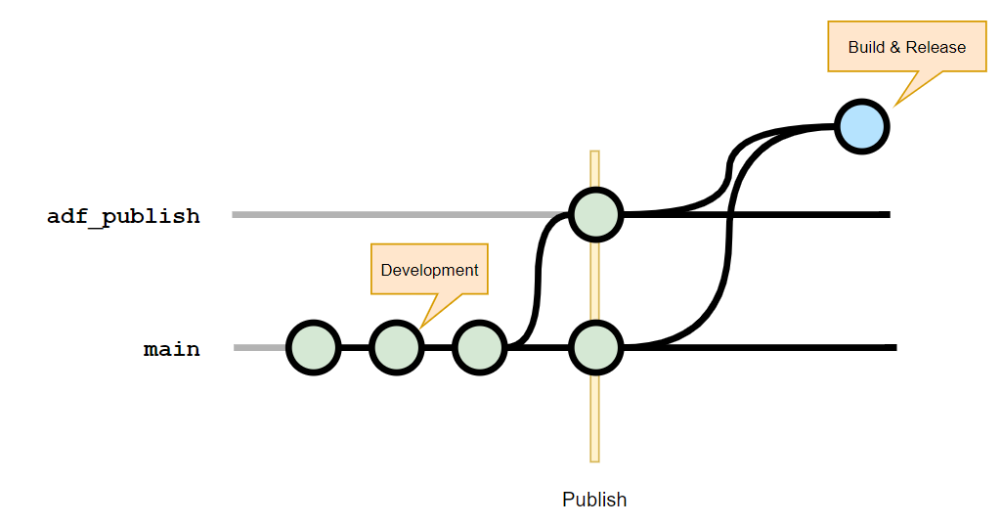
Branching

Slide 11
demo
Setup Azure DevOps – Branches
Setup Azure Data Factory
Setup Azure DevOps – Build- & Release pipelines

Slide 12
Thank you!
Erik Esmaty
e.esmaty@dymatrix.de
www.dymatrix.de/jobs

